Slide 1
Heart Disease Diagnostic Analysis

Slide 2
Problem Statement:
Health is real wealth in the pandemic time we all realized the brute effects of covid-19 on all irrespective of any status. You are required to analyse this health and medical data for better future preparation.
Do ETL: Extract- Transform and Load data from the heart disease diagnostic database
You can perform EDA through python. The database extracts various information such as Heart disease rates, Heart disease by gender, by age.
You can even compare attributes of the data set to extract necessary information. Make the necessary dashboard with the best you can extract from the data. Use various visualization and features and make the best dashboard
Find key metrics and factors and show the meaningful relationships between attributes.
Do your own research and come up with your findings.

Slide 3
Main KPIs
Attribute Information:
Age
Sex
Chest pain type (4 values)
Resting blood pressure
Serum cholesterol in mg/dl
Fasting blood sugar > 120 mg/dl
Resting electrocardiographic results (values 0, 1 ,2)
Maximum heart rate achieved
Exercise induced angina
Old peak = ST depression induced by exercise relative to rest
The slope of the peak exercise ST segment
Number of major vessels (0-3) colored by fluoroscopy
Thal: 0 = normal; 1 = fixed defect; 2 = reversable defect
Age
Sex
Cp
Trest bps
Chol
Fbs
Restecg
Thalach
Exang
Old peak
Slope
Ca

Slide 4
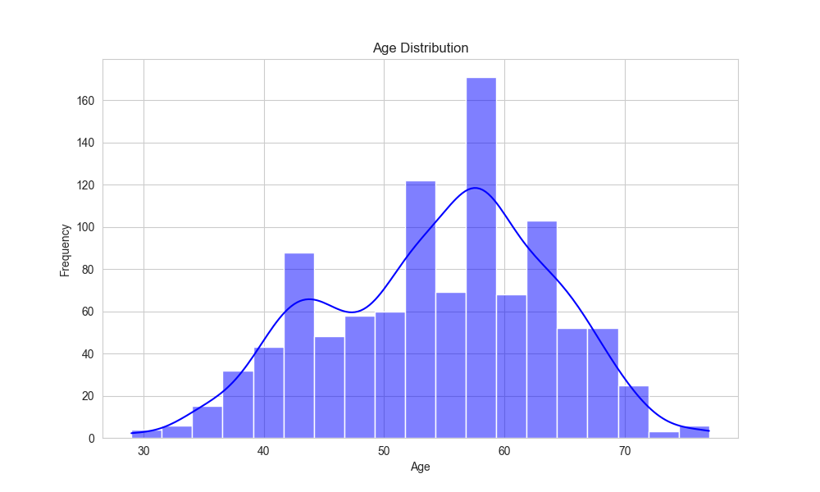
Dashboard
Heart Disease Diagnostic Analysis

Slide 5
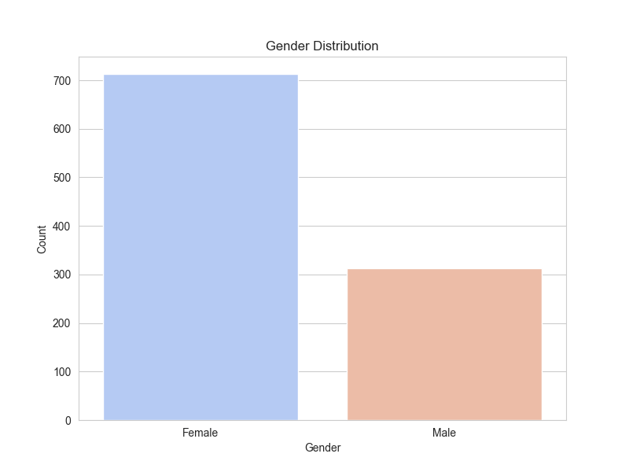
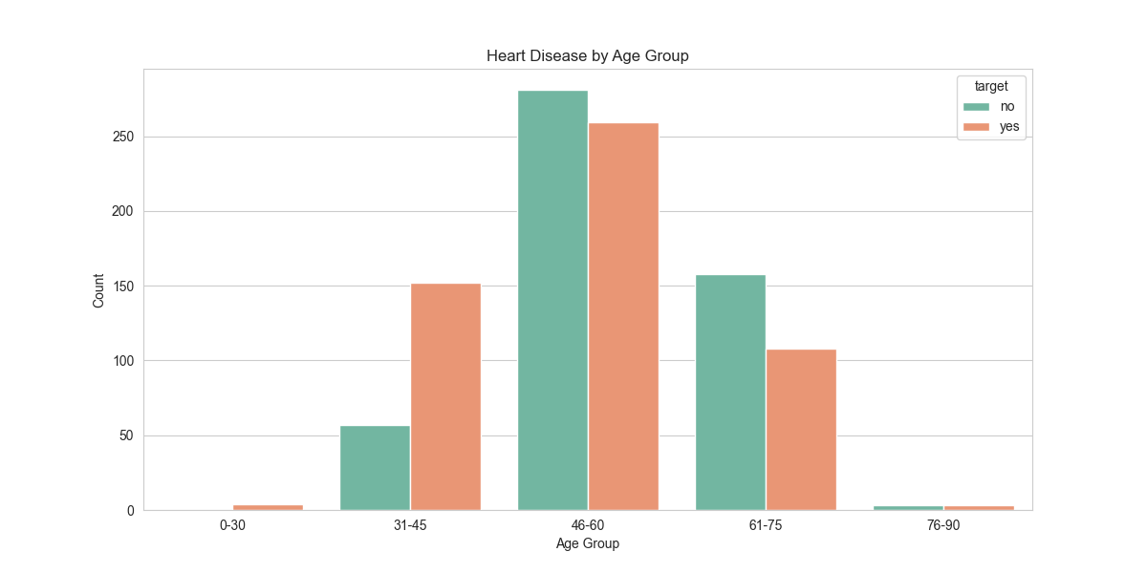

Slide 6
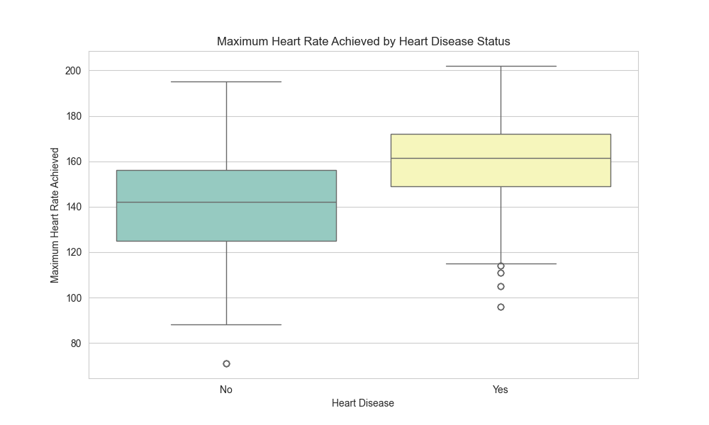
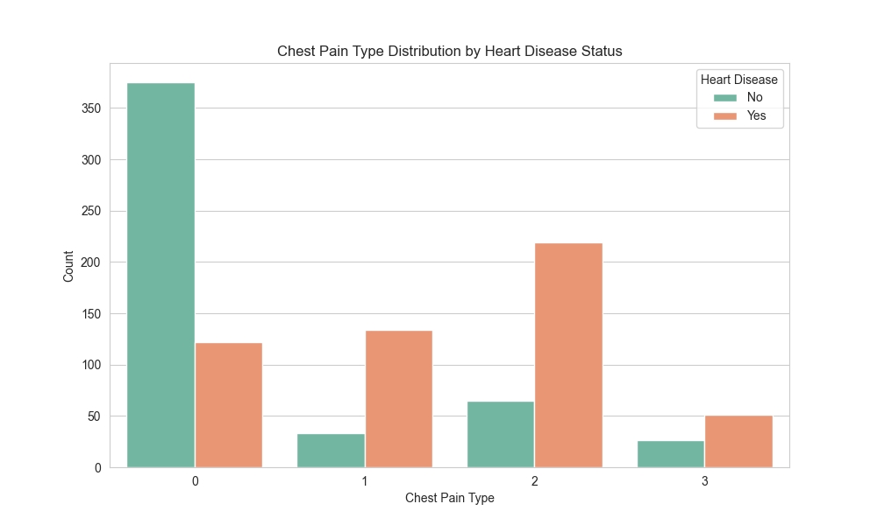

Slide 7
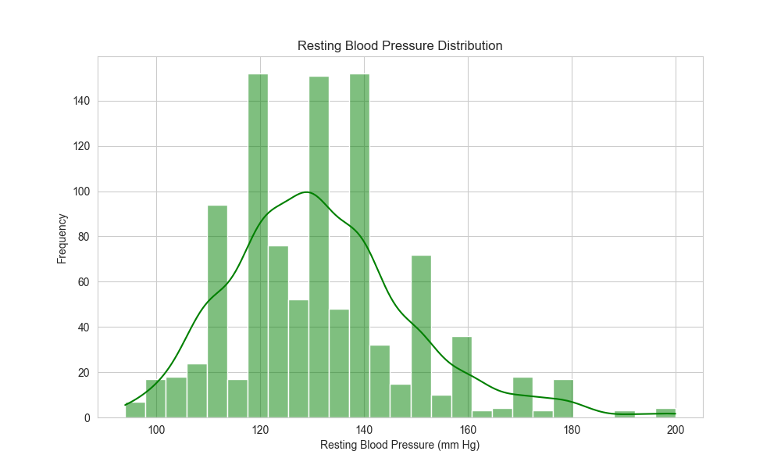
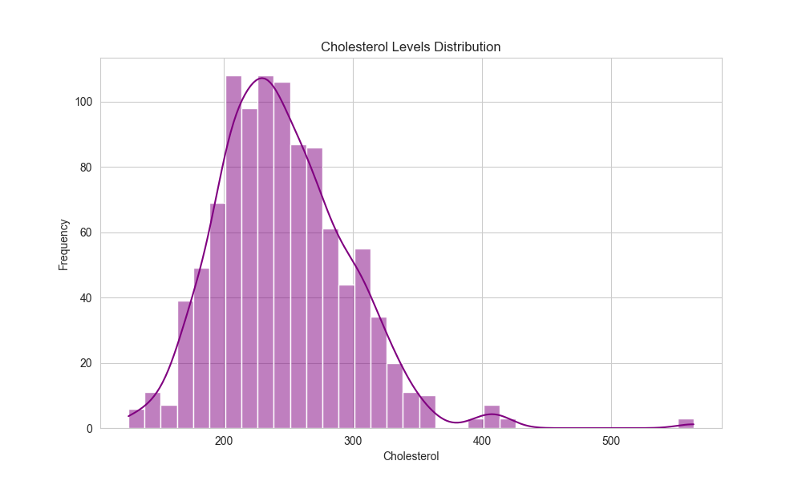

Slide 8
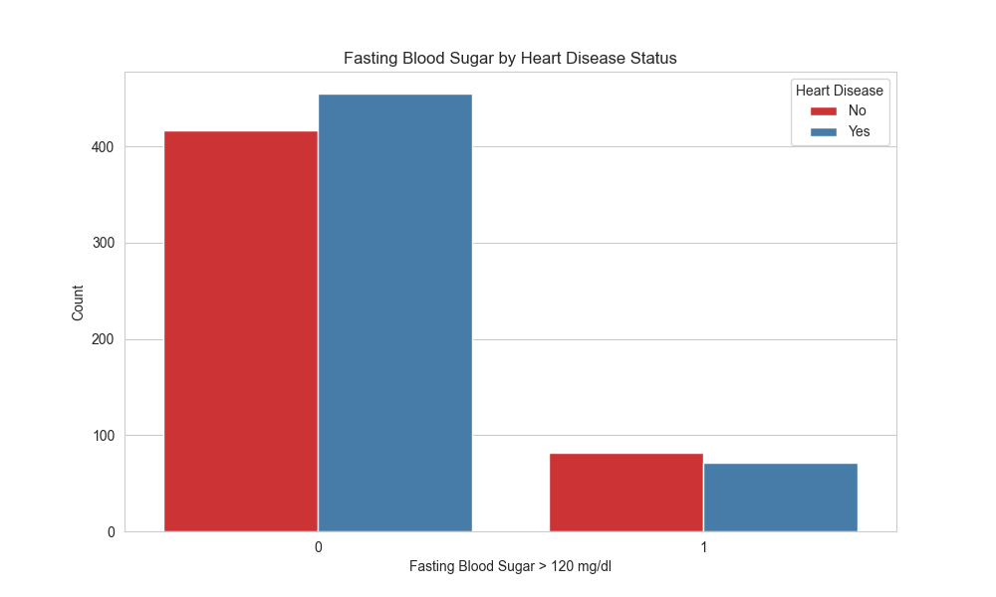

Slide 9
Main Points
# In datasets of 1025, we have 498 individuals which are not having Heart disease and remaining 527
individuals suffering from Heart Disease.
i.e.-Chart shows 51.5% suffering from heart disease.
# Male are more prone to Heart Disease.
# The people suffering from Heart Disease have non-Typical pain. Also we can see if people having
# Asymptomatic pain that doesn't mean people suffer from Heart Disease.
# We can see that a higher number of men are suffering from Typical type of Chest Pain.
# There is very high number of Typical Angina Pain in Elderly age Category.
# Blood Pressure are almost same in Male and Female and Females have little bit of higher cholesterol than
Males.
# Higher Blood pressure prone to Heart Disease. Observation found that Blood Pressure increases between
age of 50 to 60 and somehow continue the pattern till 70. Cholesterol level also increase after age of 50.
# If you suffer from Angina, you may be concerned that exercise will make your Heart Disease symptoms.
# Males have high Exercise Angina. Angina is type of chest pain caused by reduced blood flow to
the heart.
# ST depression mostly increases between the age group of 30-40 and ST depression are more in Male
compare to Female.
# More ST depression then more prone to Heart Disease.

Slide 10
Thank you

